Slide 1

Project 4 Price prediction for the ACT property market
Alistair Nguyen
Joshua Tean
Neha Sharma

Slide 2


ACT Property Market
Topic one - Introduction
Topic two – Model - 1
Topic three – Model -2
Topic four - Limitations.

Slide 3


Introduction
For our project- 04 we went with the real estate market. After dwelling into the data set from all over Australia over the last three years we decided to put our focus on ACT.
This year has seen Canberra’s property market take a tumble from the pandemic price peak; however, dwellings remain $320,000 more expensive on average than before the global pandemic hit in 2020.
Domain’s End of Year Wrap for 2022 revealed median prices were up in Canberra 41.2 per cent than the pandemic trough despite a six per cent median dwelling price decrease since the peak earlier this year.

Slide 4

Purpose of the project
The whole idea behind the project model is to try to use the historical data and train a model in a way that it can predict current values if someone were to buy property today.
We are aware that factors like price can be dependent on n number of features.
However today we are focusing on what type of property you are trying to buy.

Slide 5

Assumptions
Even though we are trying to train the model closest to the perfect the important decision of one's maybe biggest investment in life can’t be based on a few factors. Hence, we would like to clarify a few assumptions about the project.
1) No pandemic- This model is not designed with the consideration of the pandemic.
2) No first home buyer boom- we have not added a consideration for the government supports for the first home buyers.
3) No banks - Interest rates, tax savings and ease of lending these factors are not considered in the model.

Slide 6
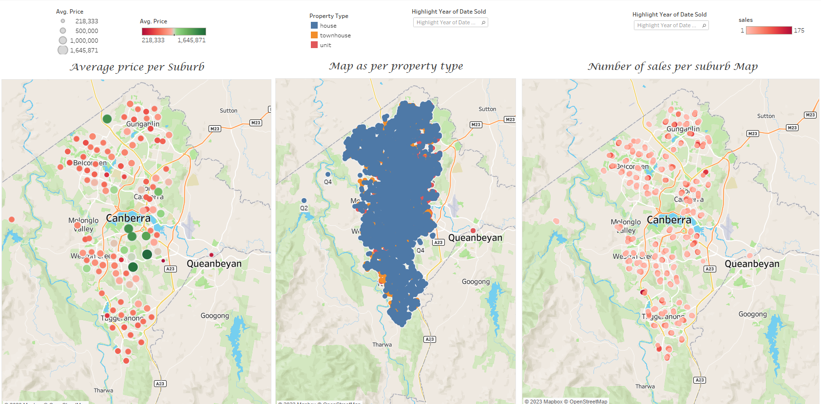

Slide 7



Topic Two

Slide 8
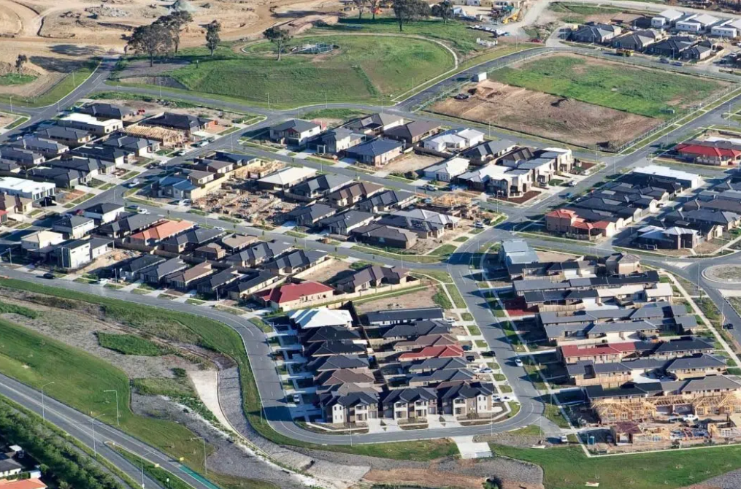
Data Collection
Data extraction
Data Modeling Implementation
Raw data obtained from https://www.kaggle.com/datasets/suryajadahake/australia-property-sales
Pandas used to clean data
All null values and states outside of ACT removed
Property Types and Date reclassified
Three test were conducted across Houses, Townhouse and Units
Narrowed down to Price bedroom and postcode
Logistic Regression
R-squared testing

Slide 9
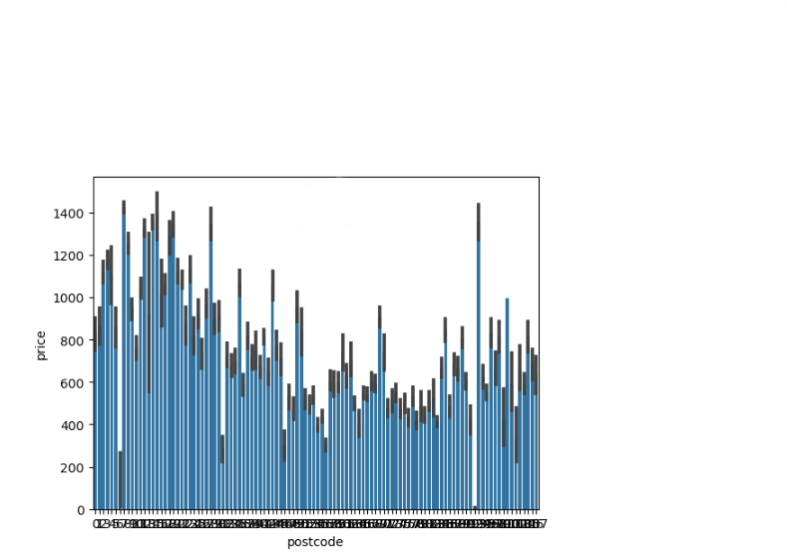
DATA Set
Parameters
Average Property Price:
- House: $795,380
- Townhouse $574,350
- Units $441,997
108 postcodes within data set.
Bedrooms range from 0 to 5 bedrooms.

Slide 10
Data Modeling Implementation
 | Logistic Regression
 | Training Data Score | Testing Data Score
House | 0.8247261 | 0.8112676
Townhouse | 0.8300475 | 0.8370672
Unit | 0.7542811 | 0.7431302

Slide 11
Data Modeling Implementation
Property Type | R-squared value
House | 0.3646825
Townhouse | 0.4428827
Unit | 0.3359805

Slide 12
Topic THREE

Slide 13
Parameters for modelling
Latitude
Longitude
No of bedrooms
Property Type
Postcode
Month sold
Year sold

Slide 14
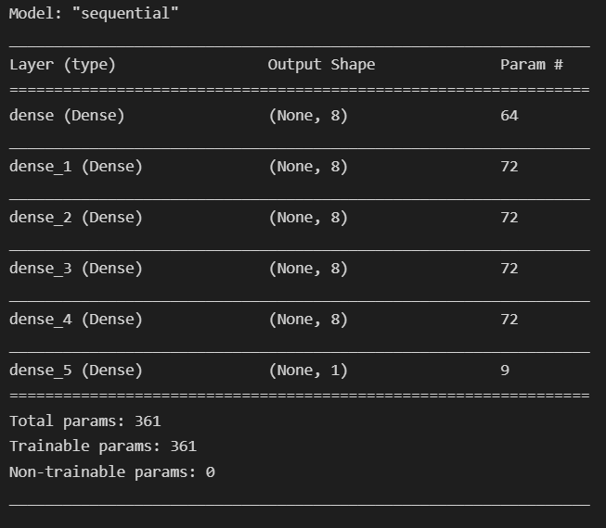
Model summary

Slide 15
Data modelling comparison
Linear Regression vs Keras Regression
 | Linear Regression | Keras Regression
Mean Absolute Error | 132944.42 | 105160.75
Mean Squared Error | 37424819461.94 | 26696349075.46
Root Mean Squared Error | 193454.95 | 163390.17
Variance Score | 57.52 | 69.71

Slide 16
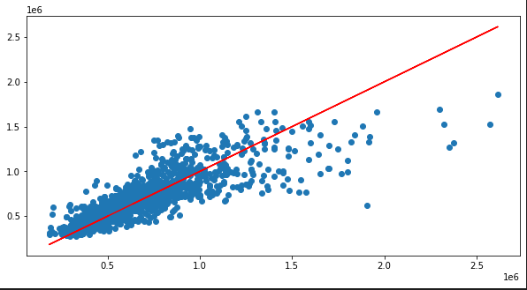
Regression line of the keras model

Slide 17
Comparison of actual data vs predicted data
Linear Regression
Keras Regression
 | Actual | Predicted
1 | 500000 | 556277
2 | 415000 | 555837
3 | 1700000 | 1031199
4 | 680000 | 831717
5 | 355000 | 385473
6 | 400000 | 395733
7 | 460000 | 520468
8 | 330000 | 392015
9 | 609000 | 770292
10 | 530000 | 483061
 | Actual | Predicted
1 | 500000 | 502713
2 | 415000 | 499446
3 | 1700000 | 1285180
4 | 680000 | 731213
5 | 355000 | 379196
6 | 400000 | 361695
7 | 460000 | 417202
8 | 330000 | 497613
9 | 609000 | 711002
10 | 530000 | 533381

Slide 18
Limitations
Bigger dataset with more parameters would be ideal
Size of the house (sqm)
No of floors
No of bathrooms
Condition
Year built

